Slide 1


Insert relevant picture related to the topic
ALGORITHMS AND DATA STRUCTURES
TEB1113/TFB2023
WEEK III
LINKED LIST – I (SINGULAR & DOUBLY)
FARAHIDA HANIM BT MAUSOR - DR (FSMC/UTP)
BACHELOR OF XXXXXX
DEPARTMENT OF COMPUTING
FACULTY OF SCIENCE, MANAGEMENT & COMPUTING
© 2026 INSTITUTE OF TECHNOLOGY PETRONAS SDN BHD
All rights reserved. No part of this document may be reproduced, stored in a retrieval system or transmitted in any form or by any means (electronic, mechanical, photocopying, recording or otherwise) without the permission of the copyright owner.

Slide 2
RECAP FROM PREVIOUS LECTURE
Arrays store same-type elements in contiguous memory.
Array elements are accessed directly using indexes.
2D arrays represent rows and columns.
Arrays are efficient for random access but fixed in size.
Notes:
Learning Outcomes Slide
Note:
Include 2–4 lecture-level learning outcomes
Use measurable action verbs
Map explicitly to Course Learning Outcomes (CLOs)

Slide 3
LEARNING OUTCOMES
Explain the structure of a linked list using nodes and pointers.
Compare arrays and linked lists in terms of access, memory, insertion, and deletion.
Differentiate singly and doubly linked lists.
Implement insertion, traversal, and deletion operations in C++.
Notes:
Learning Outcomes Slide
Note:
Include 2–4 lecture-level learning outcomes
Use measurable action verbs
Map explicitly to Course Learning Outcomes (CLOs)

Slide 4
TOPICS
Linked List Concept
Node, Head, and Pointer Structure
Advantages and Disadvantages
Singly Linked List
Doubly Linked List
C++ Lab Practice
Notes:
Learning Outcomes Slide
Note:
Include 2–4 lecture-level learning outcomes
Use measurable action verbs
Map explicitly to Course Learning Outcomes (CLOs)

Slide 5

LINKED LIST – I
(SINGULAR & DOUBLY)
Introduction

Slide 6
INTRODUCTION
1.1. WHAT IS A LINKED LIST?
A Linked List is a linear data structure, and it is a very common data structure that consists of a group of nodes in a sequence, which is divided into two parts.
Each node consists of its data field and the address field. The data field is used to store the data, and the address field is used to store the address of its adjacent nodes.
The first node of a linked list is called head, and only the address of the first node is stored to store a linked list.
All other nodes can be accessed from the first node itself by sequentially exploring the adjacent nodes.
Notes:
Engagement and Activity Slides
Note:
Include at least one engagement element where appropriate:
Think–Pair–Share
Mini task
Poll or reflection question
Suggested duration: 3–5 minutes
Activities shall align with learning outcomes

Slide 7
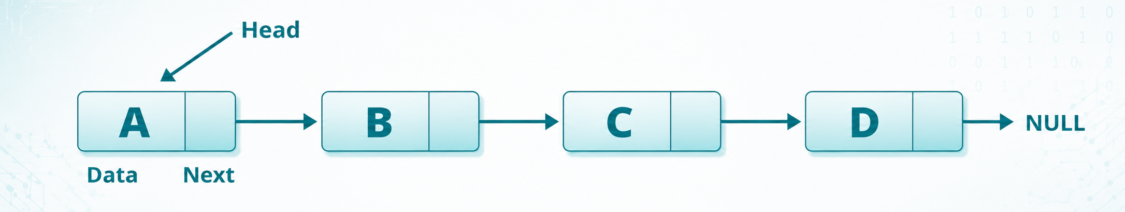
INTRODUCTION
1.1. SINGLY LINKED LIST
Notes:
Engagement and Activity Slides
Note:
Include at least one engagement element where appropriate:
Think–Pair–Share
Mini task
Poll or reflection question
Suggested duration: 3–5 minutes
Activities shall align with learning outcomes

Slide 8
INTRODUCTION
1.1. ADVANTAGES OF LINKED LIST
Advantage | Meaning
Dynamic size | Memory is allocated when needed
Easy insertion/deletion | Nodes can be added or removed by changing pointers
Flexible memory use | Does not require contiguous memory
Useful for ADTs | Can support stacks, queues, and graphs
Notes:
Engagement and Activity Slides
Note:
Include at least one engagement element where appropriate:
Think–Pair–Share
Mini task
Poll or reflection question
Suggested duration: 3–5 minutes
Activities shall align with learning outcomes

Slide 9
INTRODUCTION
1.1. DISADVANTAGES OF LINKED LIST
No random access To find an element, traversal starts from the head.
Search is slower Searching takes O(n) time.
Extra memory is required Each node stores one or more pointer fields.
This slide should include a small comparison with arrays:
Array: A[3] → direct access
Linked List: Head → Node1 → Node2 → Node3
Notes:
Engagement and Activity Slides
Note:
Include at least one engagement element where appropriate:
Think–Pair–Share
Mini task
Poll or reflection question
Suggested duration: 3–5 minutes
Activities shall align with learning outcomes

Slide 10
INTRODUCTION
1.1. SINGLY LINKED LIST
Singly linked lists contain nodes that have a data part as well as an address part, i.e., next, which points to the next node in the sequence.
In a single-linked list, from any node, there is no way to reach its previous node.
The operations we can perform on singly linked lists are insertion, deletion, and traversal.
Notes:
Engagement and Activity Slides
Note:
Include at least one engagement element where appropriate:
Think–Pair–Share
Mini task
Poll or reflection question
Suggested duration: 3–5 minutes
Activities shall align with learning outcomes

Slide 11
INTRODUCTION
1.1. DOUBLY LINKED LIST
In a doubly linked list, each node maintains two pointers, namely 𝑃𝑟𝑒𝑣 and 𝑁𝑒𝑥𝑡.
These are used to store the previous and next adjacent elements, respectively.
The first link points to the previous node, and the next link points to the next node in the sequence.
Notes:
Engagement and Activity Slides
Note:
Include at least one engagement element where appropriate:
Think–Pair–Share
Mini task
Poll or reflection question
Suggested duration: 3–5 minutes
Activities shall align with learning outcomes

Slide 12
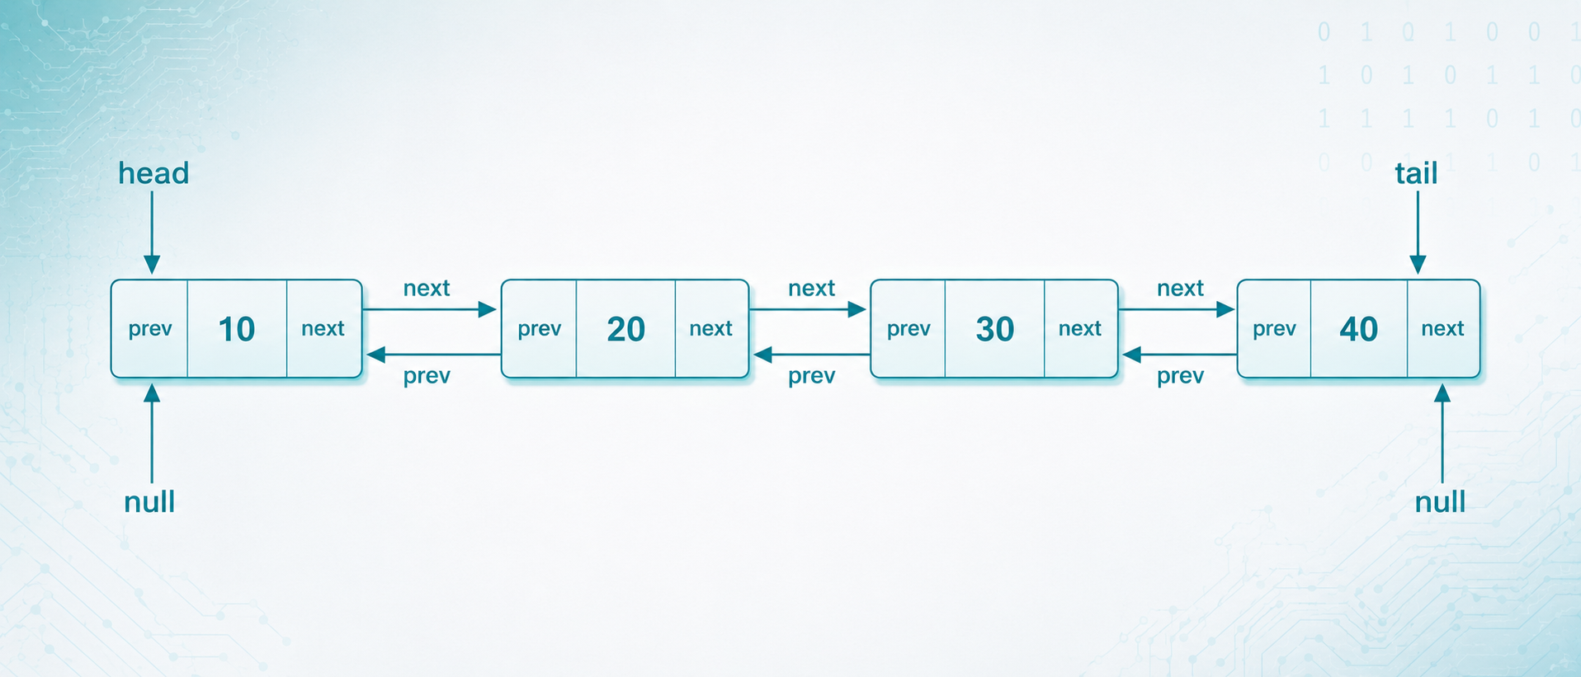
DOUBLY LINKED LIST VISUAL
Notes:
Engagement and Activity Slides
Note:
Include at least one engagement element where appropriate:
Think–Pair–Share
Mini task
Poll or reflection question
Suggested duration: 3–5 minutes
Activities shall align with learning outcomes

Slide 13
DOUBLY LINKED LIST VS SINGLY LINKED LIST
Feature | Singly Linked List | Doubly Linked List
Pointers per node | One: next | Two: prev, next
Direction | Forward only | Forward and backward
Memory use | Lower | Higher
Deletion | Needs previous node tracking | Easier if node is known
Complexity | Simpler | More flexible
Notes:
Engagement and Activity Slides
Note:
Include at least one engagement element where appropriate:
Think–Pair–Share
Mini task
Poll or reflection question
Suggested duration: 3–5 minutes
Activities shall align with learning outcomes

Slide 14
ARRAY VS LINKED LIST
Feature | Array | Linked List
Memory layout | Contiguous | Non-contiguous
Size | Fixed or resized manually | Dynamic
Access | Direct using index | Sequential from head
Insertion/deletion | Costly in middle | Easier with pointer changes
Extra memory | No pointer overhead | Requires pointer fields
Notes:
Engagement and Activity Slides
Note:
Include at least one engagement element where appropriate:
Think–Pair–Share
Mini task
Poll or reflection question
Suggested duration: 3–5 minutes
Activities shall align with learning outcomes

Slide 15
SUMMARY
TODAY’S KEY TAKEAWAYS:
A linked list is made of nodes connected using pointers.
The first node is called the head.
Singly linked lists allow forward traversal only.
Doubly linked lists allow forward and backward traversal.
Linked lists are dynamic but require extra memory for pointers.
Common operations include insertion, traversal, and deletion.
Notes:
Engagement and Activity Slides
Note:
Include at least one engagement element where appropriate:
Think–Pair–Share
Mini task
Poll or reflection question
Suggested duration: 3–5 minutes
Activities shall align with learning outcomes

Slide 16
LAB TASK
CREATE A C++ PROGRAM
Part A: Singly Linked List
Add a node.
Display the list.
Delete a node by value.
Part B: Doubly Linked List
Add a node.
Display the list forward.
Display the list backward.
Delete a node by value.
Notes:
Engagement and Activity Slides
Note:
Include at least one engagement element where appropriate:
Think–Pair–Share
Mini task
Poll or reflection question
Suggested duration: 3–5 minutes
Activities shall align with learning outcomes

Slide 17

THANK YOU
FARAHIDA HANIM BT MAUSOR - DR (FSMC/UTP)
DEPARTMENT OF COMPUTING
farahida.mausor@utp.edu.my
02-03-26

